Slide 1

Lecture 6

Slide 2
Topics
Technical Presentations

Slide 3
Criteria for Success
The presentation starts with the motivating problem for the research and why it’s being presented.
Every slide shows something relevant to the motivating problem.
Every slide shows no more information than necessary to convey the message.
Slide titles stand on their own; other text supports the visuals.
The audience takes away the presenter’s desired message.

Slide 4
Identify Your Message and Purpose
Figure out what you want to convey
Present information, elicit feed-back, gain buy-off, secure more funding, etc.
In most settings you can indicate what your purpose is:
“I would appreciate your feedback on….”
“We are present on _____ and why it is something we should pursue…”
Make it easy to understand your message/purpose
Structure is important
Start with only the most important information.
Then add details as necessary

Slide 5
Understand Your Audience
One of the most important things
Highlight your goals with what the audience cares about
Steer the audience towards what you want to convey
Eliminate jargon
Whenever possible have someone outside of your immediate structure, who has the audiences' backgrounds and interests give you feedback on your presentation prior.

Slide 6
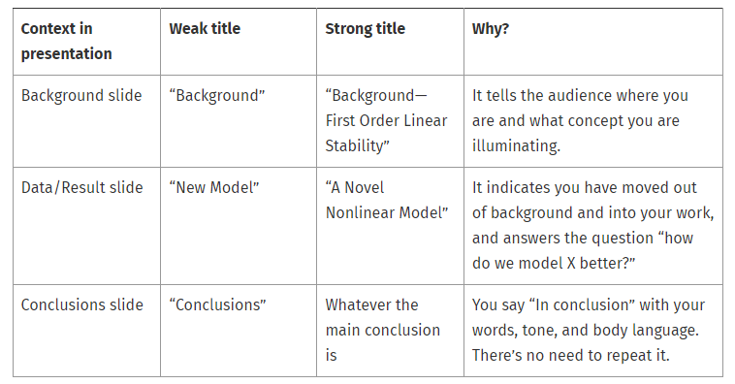
Each Slide Conveys a Single Point
Each slide contains a single point
Strong titles convey a message
The title should let the audience know where you are in the presentation

Slide 7
Visuals/Figures Are Important
People can’t read and listen at the same time well
But can interpret figures/data and listen
Use brief statements and keywords. Then replace with visuals and figures whenever possible
Replacing text with figures, tables, or lists.
Eliminating all but key words and phrases, speak the rest
Breaking up the slide into multiple slides with more visuals.
Simplify figures

Slide 8
Introduce Your Data
Introduce your data before you present it
Make sure when they see the info that they will be able to understand and interpret it
If your audience might not understand your data, show sketches that give comparison and explain
i.e. “This is what the normal signal we were expecting to see, and this is what we interpreted…..”
Include Keywords, labels, or legends

Slide 9
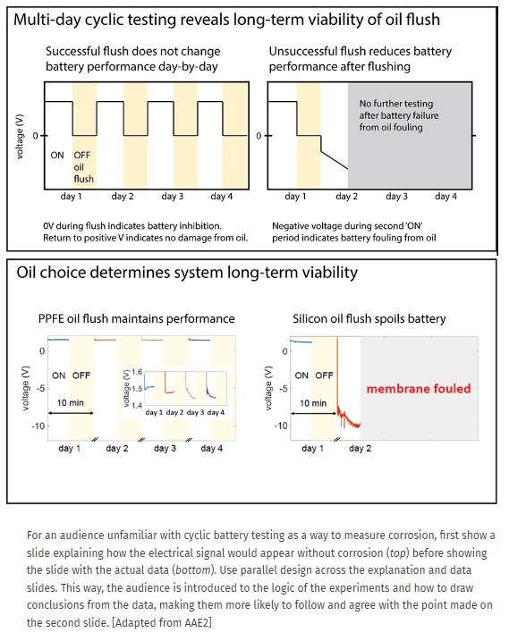

Slide 10
Be simple, and consistent in design
Consistent slide design
Font, size, figures
Don’t be distracting
Colors, animations, flashiness
Don’t be afraid of white space
Ensure everything is legible
From every position in the room
Consistently align your slides
Use built-in features
You are presenting => Present
Let your slides support your presentation, not your presentation support your slides

Slide 11
K.I.S.S.
Keep
It
Simple
Student

Slide 12
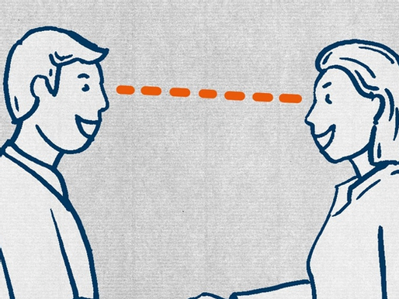
Good Practices
Be Concise
Receive feedback from multiple points of views
Especially important if persuading
PRACTICE
Anticipate questions
Think of your answers prior
Address concerns in your slides
Eye Contact and Engagement
Be Enthusiastic
Highlight/emphasize the main points

